Slide 1

República de Moçambique
Província de Inhambane
Conselho Executivo Provincial de Inhambane
INHAMBANE'S EXPERIENCE IN TERRITORIAL MANAGEMENT.
Novembro de 2025

Slide 2
1. Contextualization
The province of Inhambane is located in the southern region of Mozambique. Its capital is the city of Inhambane, situated approximately 500 km north of the city of Maputo.
Area of ​​the province: 68,615 km²
Total population of Inhambane province: 1,616,068 inhabitants.
Women: 859,797 (53.2%)
Men: 756,271
Population density: 23.5 inhabitants/km²
Annual population growth rate of the province: 1%;
Inhambane's coastline: 700 km (25% of Mozambique's coastline);

Slide 3
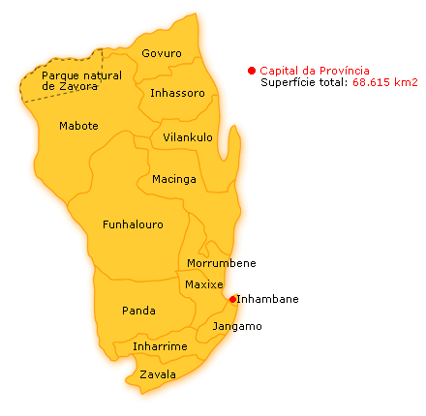
1. Contextualization-Inhambane Province

Slide 4
1. Contextualization (cont.)
One of the faces of poverty in Mozambique is the disorganized occupation of physical space, especially in rapidly developing urban areas. Factors contributing to this disordered occupation of space include:
The 16-year war that ravaged the country moved a large portion of the population from rural areas to cities and towns;
Rural exodus, which primarily moves young people to cities and towns in search of employment opportunities and to continue their studies;
The introduction and implementation of various socio-economic development projects;
The impact of drought on agriculture; and
Population growth.

Slide 5
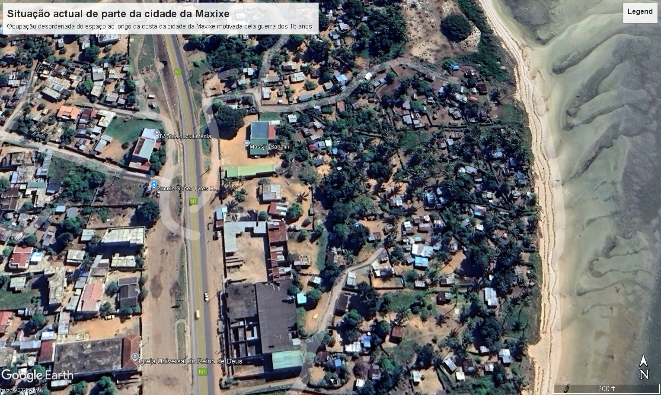
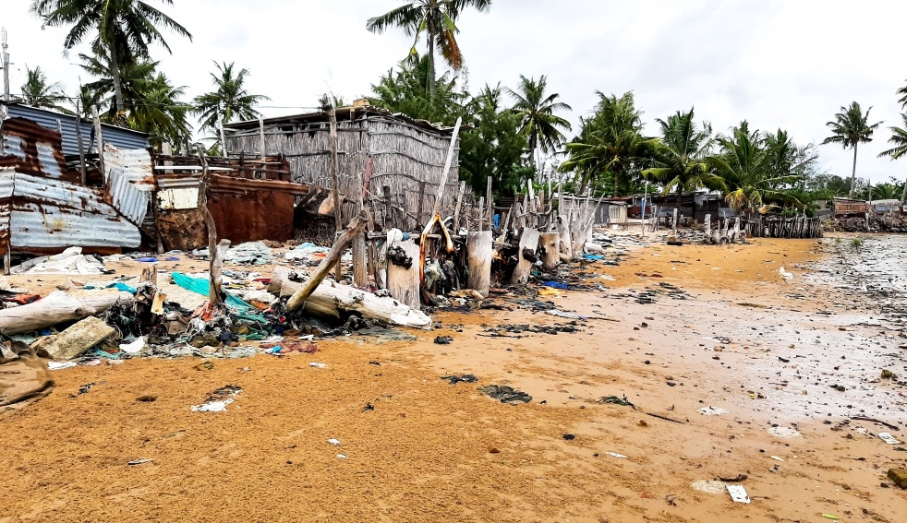
Disorganized occupation of physical space in coastline in Maxixe

Slide 6
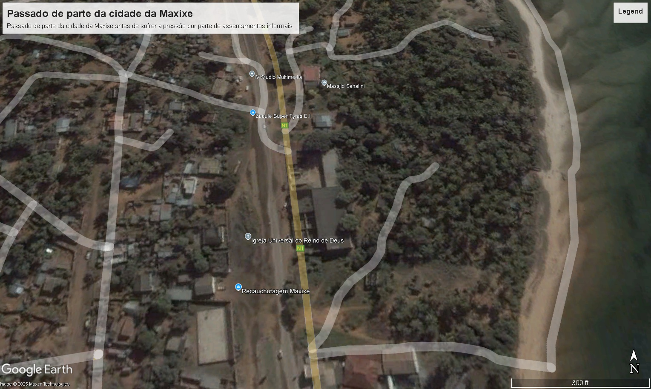
Before the disorderly occupation

Slide 7
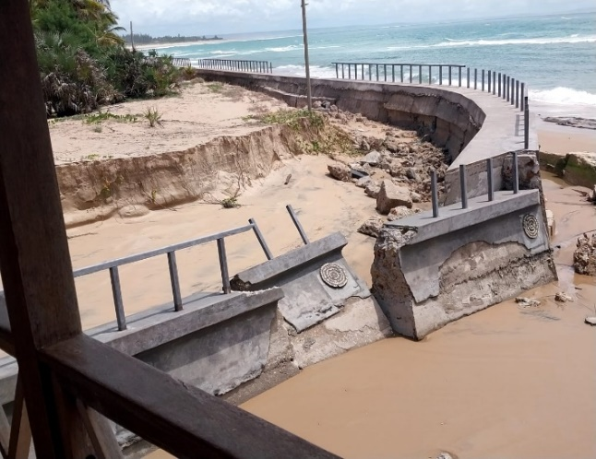
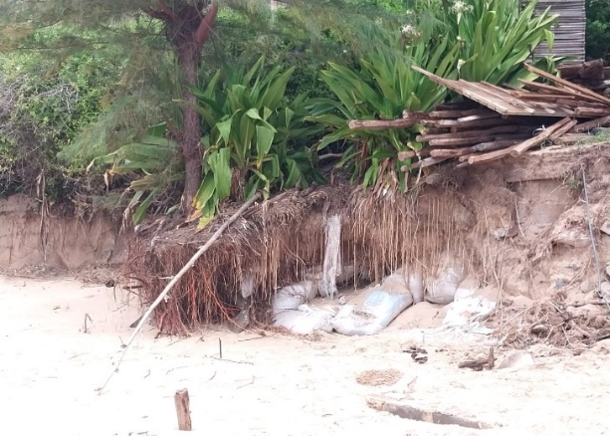
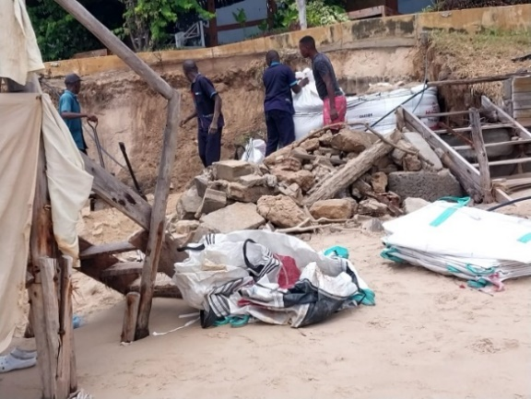
The problems of the coastline in Inhambane-Barra beach

Slide 8
2. Urbanization System in Mozambique
Urbanization Policy
Aware of the importance of territorial planning, the Assembly of the Republic of Mozambique approved the Urbanization Policy (UP), through Resolution No. 31/2024 of July 10, in order to ensure and guarantee the promotion of more balanced urbanization and harmonious development of the territory, and to promote socio-economic development, fostering greater equity, spatial inclusion and the reduction of spatial inequalities.

Slide 9





NATIONAL TERRITORIAL DEVELOPMENT PLAN (PNDT)
2. Urbanization System in Mozambique-
2.1. Hierarchical System of Territorial Planning in Mozambique
SPECIAL LAND USE PLANS
STRATEGIES, STANDARDS AND GUIDELINES
PROVINCIAL
Provincial Territorial Development Plans
DISTRICT
DISTRICT LAND USE PLAN
URBANIZATION PLANS
TERRITORIAL AND URBAN MANAGEMENT
URBAN STRUCTURE PLAN
AUTONOMOUS
DETAILED PLANS

Slide 10
3. Pillars of Development in PPDT
Transportation corridors for goods and people, providing access to development hubs equipped with public utility services;
Railway line;
Tourism development, especially in coastal areas;
Establishment of ecological corridors;
Restoration and protection of mangroves;
Implementation of agroecological, aquaculture, and fish farming projects.

Slide 11
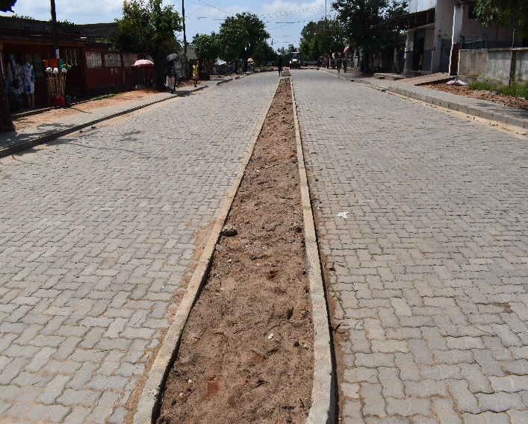
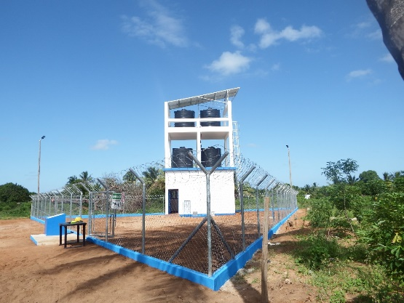
3.1. Transportation corridors for goods and people, providing access to development hubs equipped with public utility services;

Slide 12
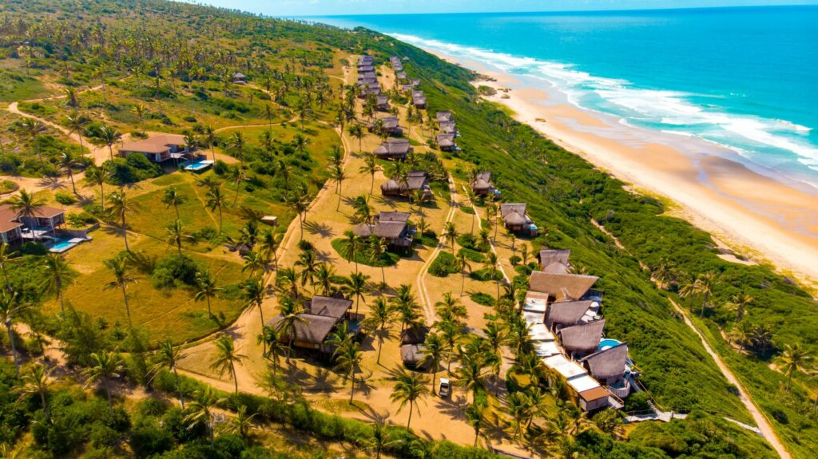

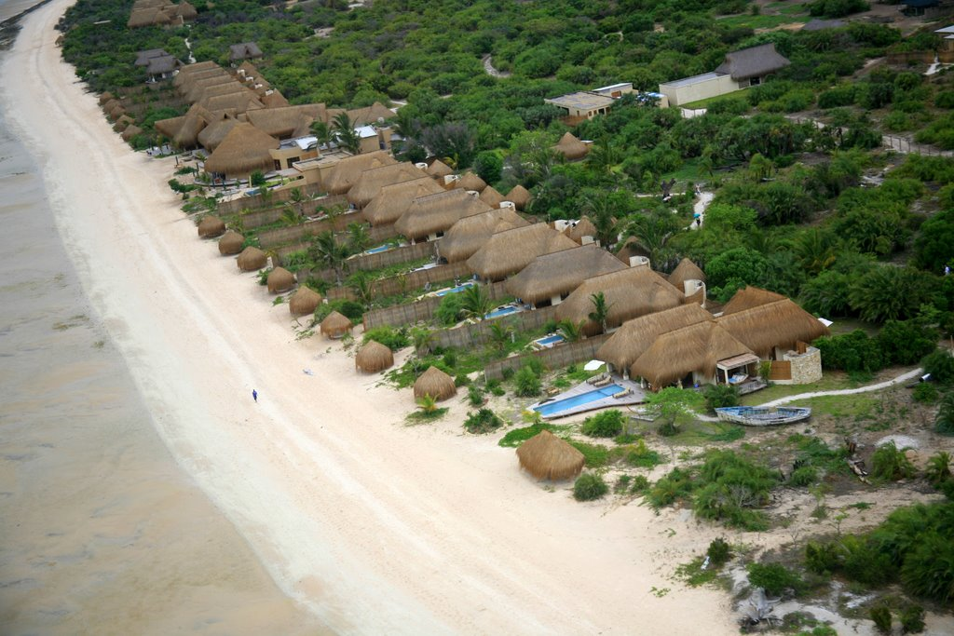
3.2. Tourism development, especially in coastal areas

Slide 13
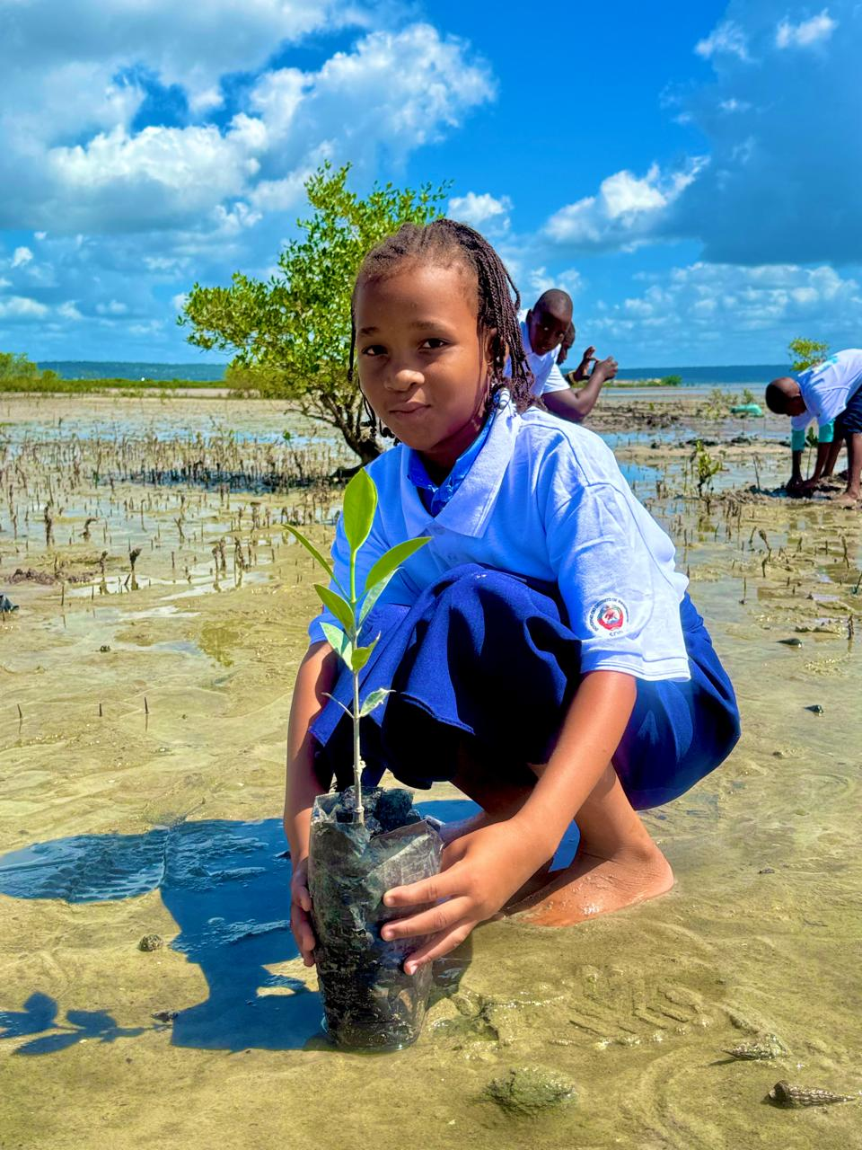
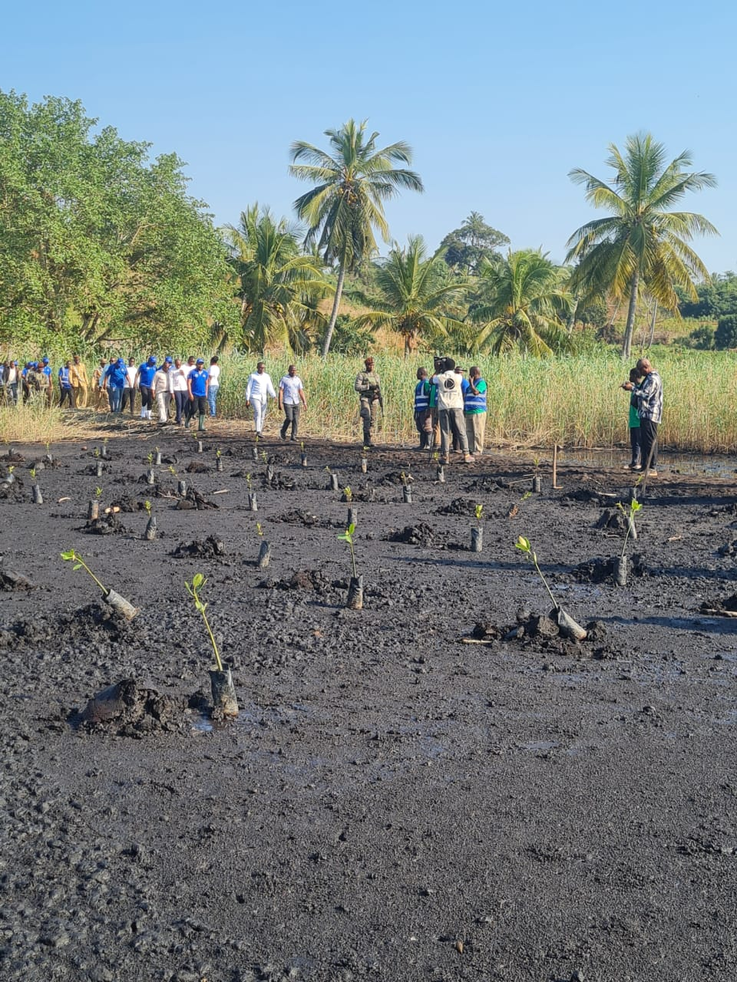
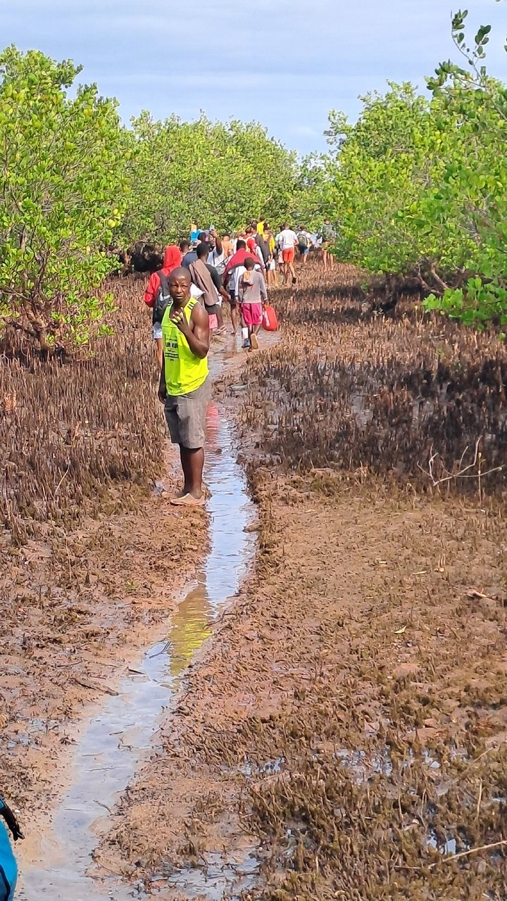
3.3. Restoration and protection of mangroves

Slide 14
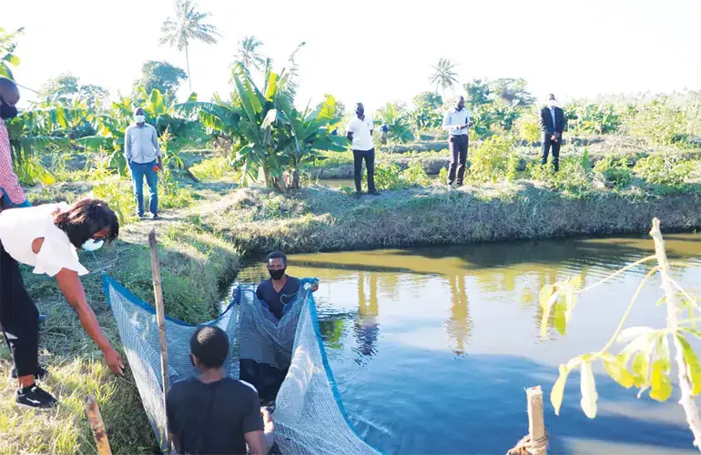
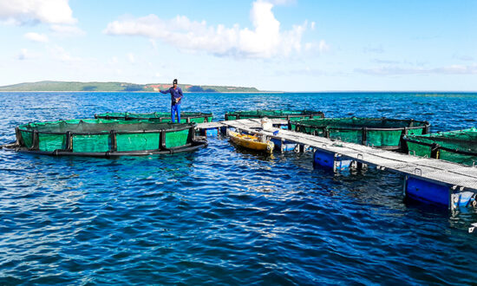

3.4. Implementation of agroecological, aquaculture, and fish farming projects

Slide 15
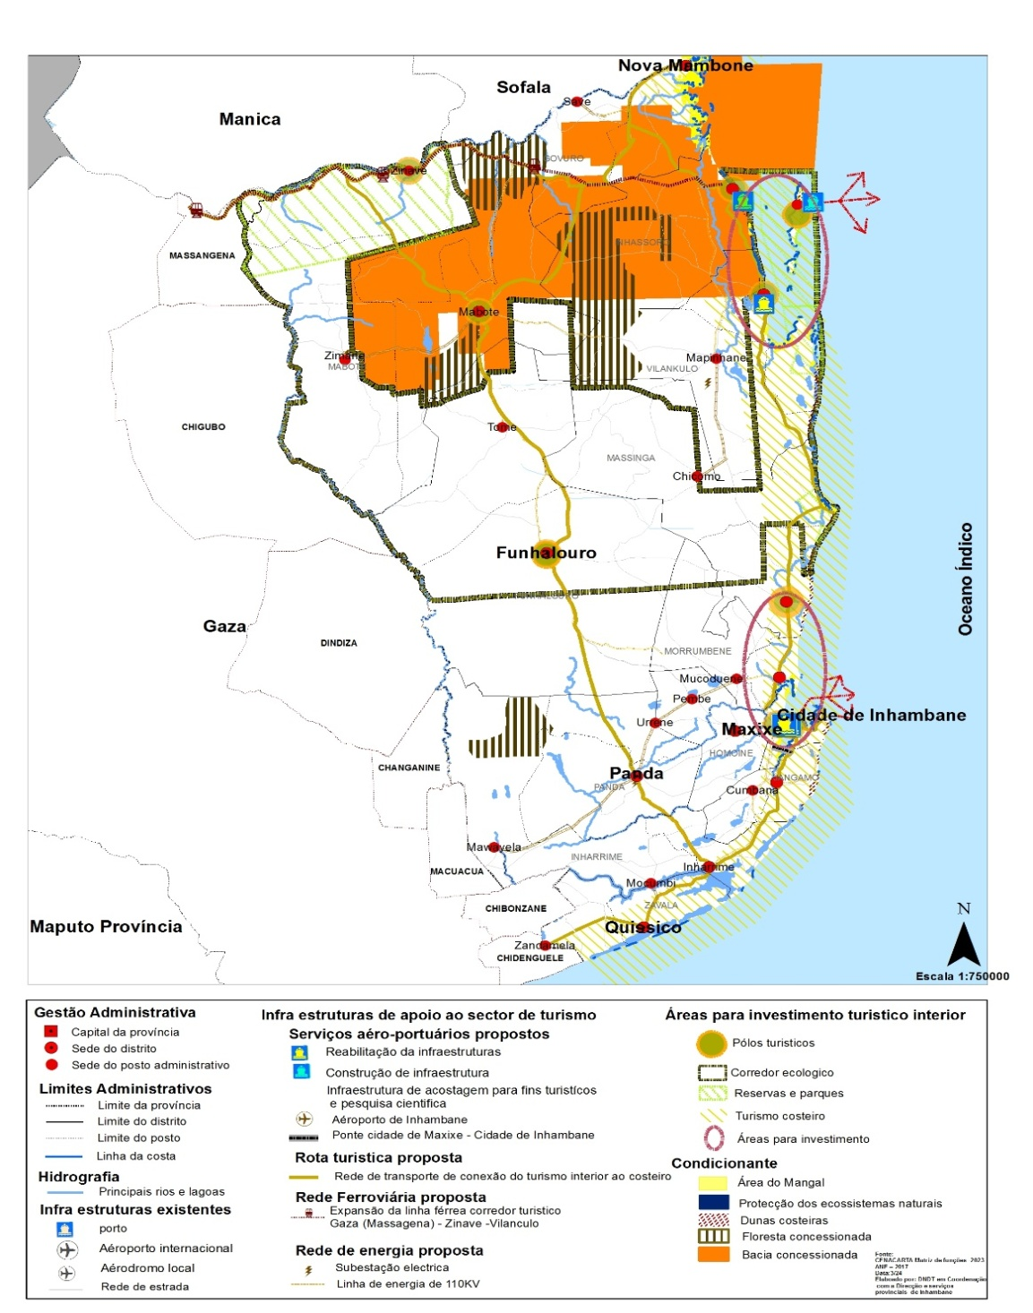
4. Problems and potential identified in territorial occupation.
High climate vulnerability of the province:
-Exposure: 2/3 of the population lives in the coastal zone; and
-Sensitivity: fragility of most infrastructures;
High tourism potential (increased entry of investment projects in the tourism sector (154 projects from 2024 - 1st quarter of 2025);
Greater potential for forest resources;
Existence of 4 areas of conservation of marine, coastal and terrestrial biodiversity.

Slide 16
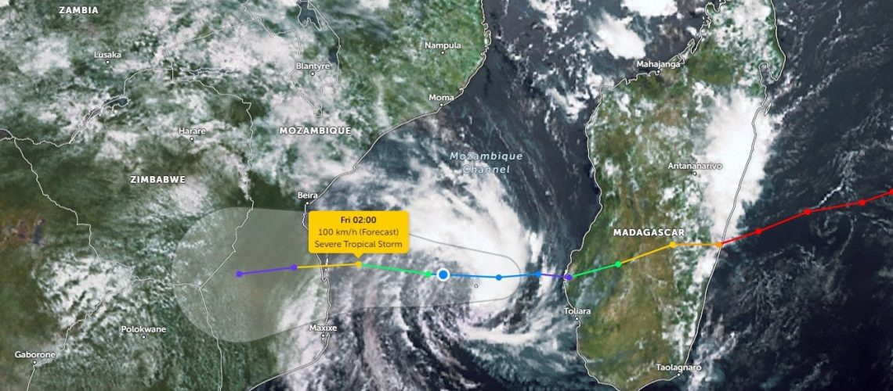
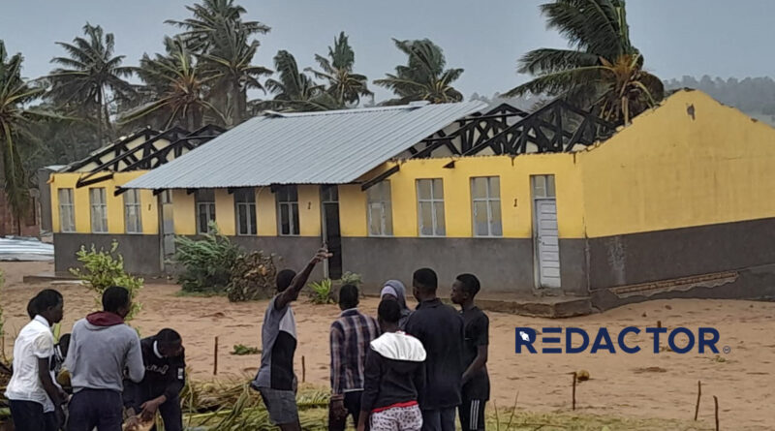

4. Problems and potential identified in territorial occupation

Slide 17
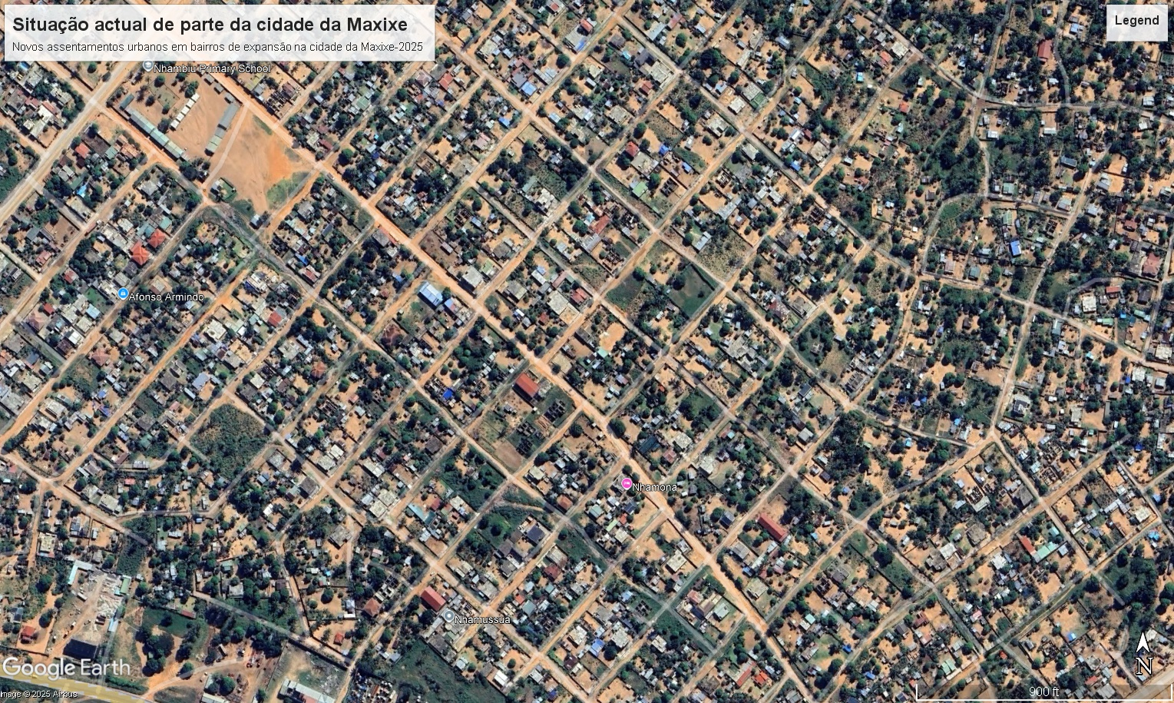
5. Territorial Planning in Inhambane- How to reverse the current scenario of disordered occupation.
Development and implementation of 10 Urban Structure Plans in an equal number of territorial units

Slide 18
5. Territorial Planning in Inhambane- How to reverse the current scenario of disordered occupation
Integrated and Inclusive Territorial System
As part of the implementation of the SIRI project, a digital system was planned and designed to allow the storage and sharing of territorial planning plans in the cloud, thus ensuring access to environmental information as well as information on occupied plots with Land Use Rights (DUAT).
This initiative was developed by Eduardo Mondlane University, through the Center for Support to Information and Community Communication (CAICC).

Slide 19
5. Territorial Planning in Inhambane- How to reverse the current scenario of disordered occupation
UNISAVE makes a significant contribution to the Provincial Executive Council in the careful selection of priority projects for the province of Inhambane, in their design, and in assisting with the design of structuring projects to boost local development.

Slide 20
6. The reason for these actions
Need to achieve objectives defined in different international and national strategic planning instruments:
-Sustainable Development Goals (SDGs – Agenda 2030)
-National Development Strategy (2025-2044);
-Provincial Territorial Development Plan (2024-2044)
-Five-Year Plan of the Provincial Executive Council of Inhambane (2025-2029)

Slide 21
7. Expected Results
Reduced environmental degradation resulting from the already orderly occupation of the space; and
Increased climate resilience.

Slide 22
8. Challenges
To enhance the current adaptive capacity of local communities to Climate Change (CC) through the implementation of Local Climate Change Adaptation Plans;
To improve coastal protection;
To strengthen local capacity for the development and implementation of Territorial Planning Plans, with emphasis on updating District Land Use Plans; and
To make human settlements, villages and cities climate-resilient and safe.

Slide 23
MUITO OBRIGADO

