Slide 1
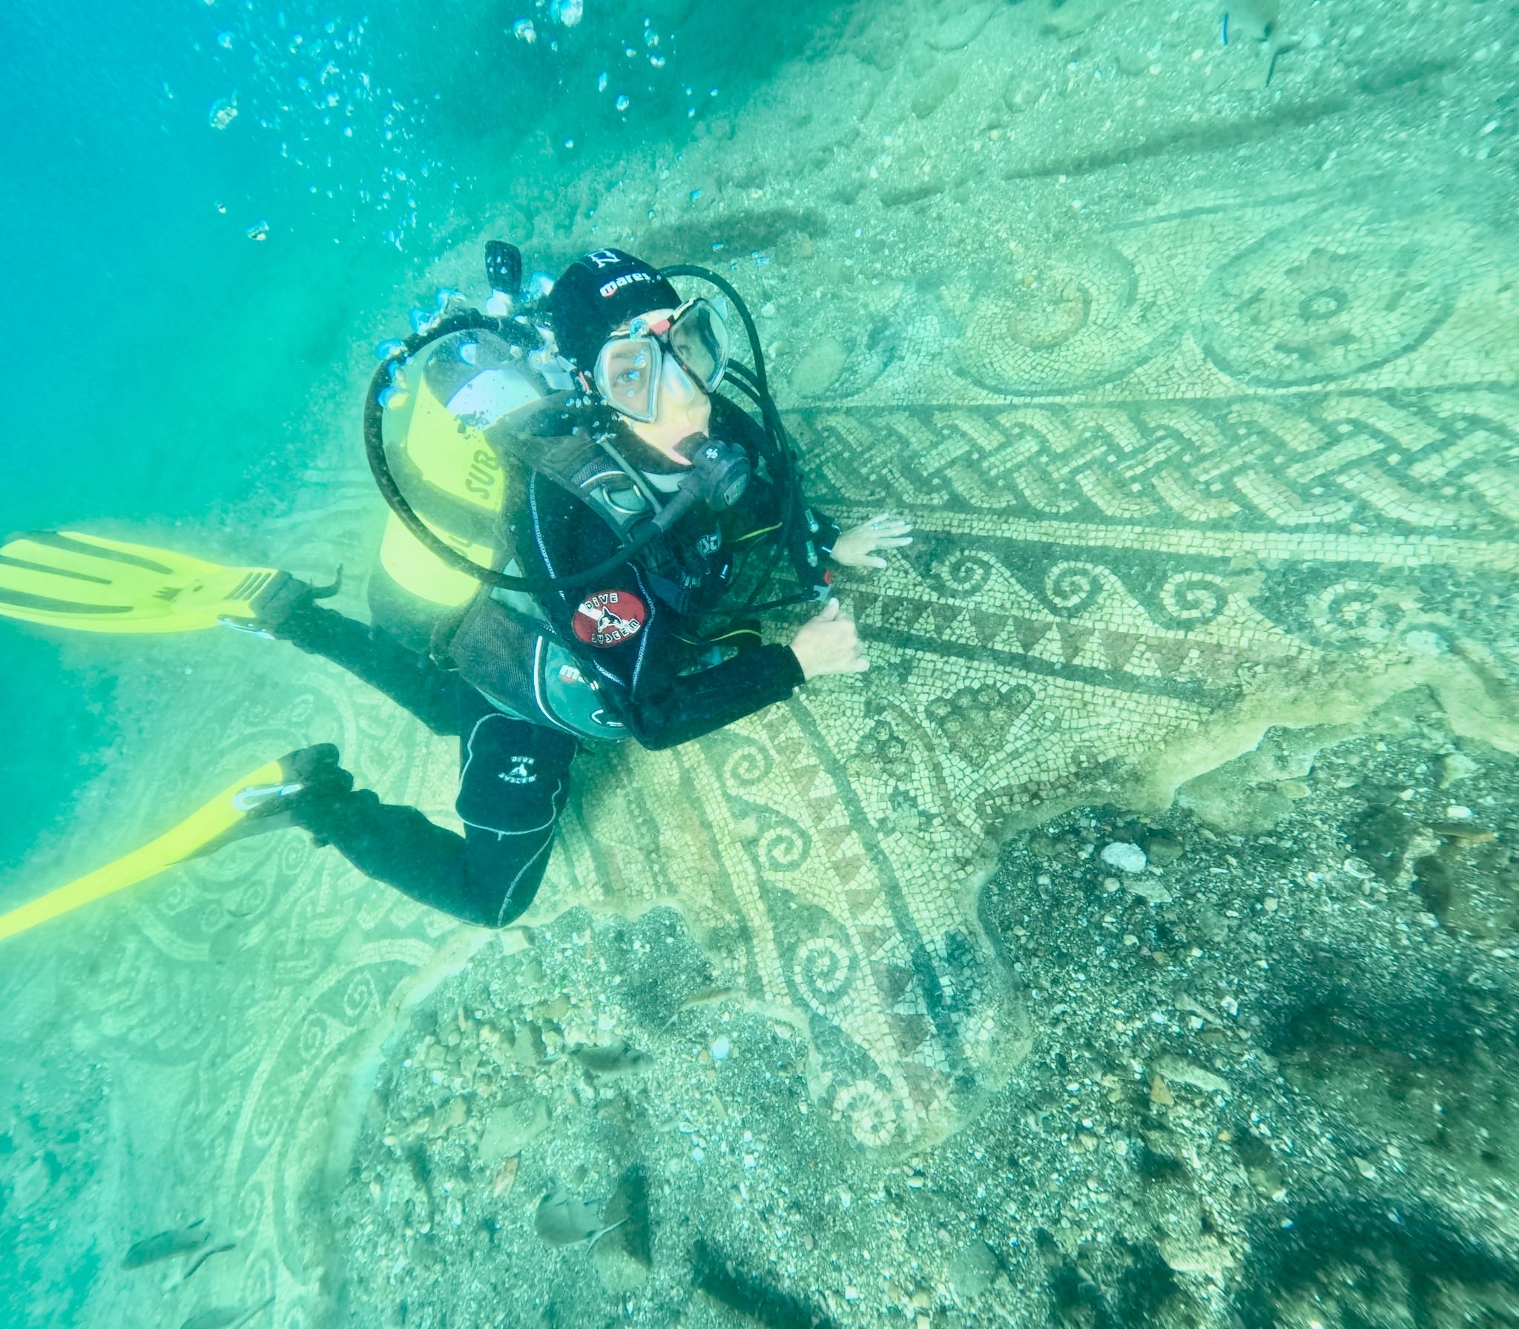
The Mosaics of the Underwater Park of Bacoli in Naples
Ancient mosaic from Roman Imperial-age villas (1st cent. BC), now lie underwater due to the volcanic phenomenon of bradyseism.
Still studied and protected today, they symbolize the strong link between cultural heritage, the environment, and the local community — a connection that continues to generate social and economic value.
Courtesy of Arch. Filomena Lucci
https://www.parcoarcheologicosommersodibaia.it/

