Slide 1

Biennale of Sustainability in Venice
Natalia Alonso Cano
Chief, Regional Office for Europe and Central Asia
United Nations Office for Disaster Risk Reduction

Slide 2
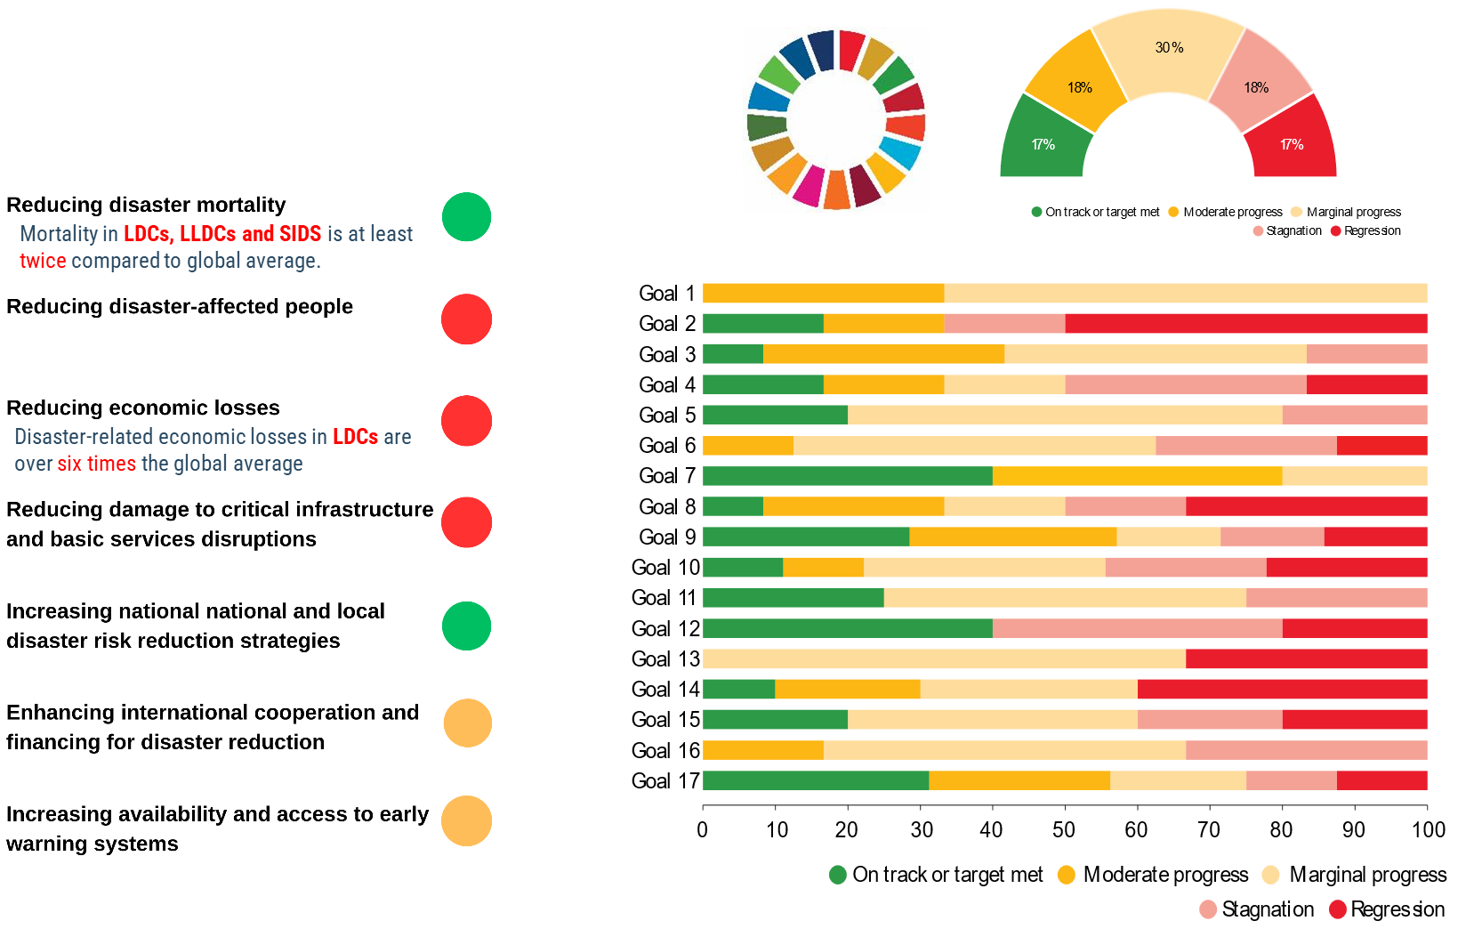

10 years of the Sendai Framework: Overall progress in DRR in the context of sustainable development

Slide 3
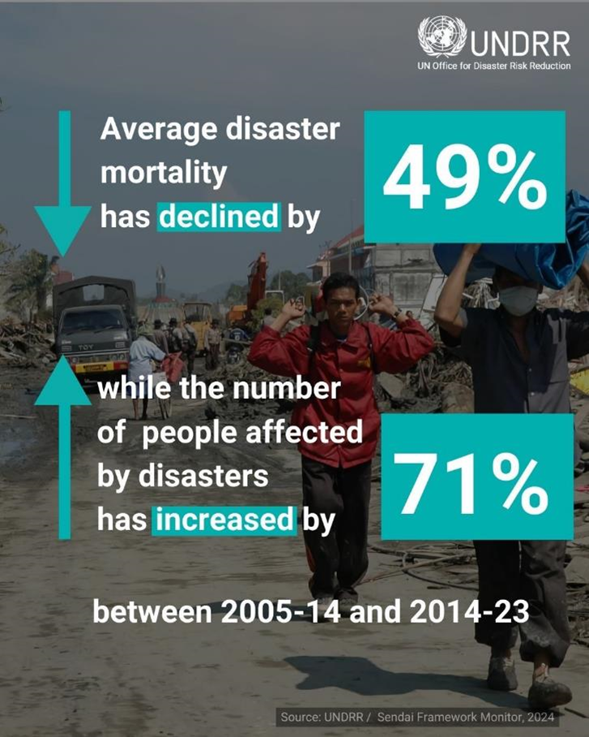
Progress & Peril in proximity

Slide 4
Challenges on locally-led DRR
Limited local capacity
Lack of the technical, financial, and human resources to implement DRR effectively
Weak local risk data & analysis
Inadequate inclusion and participation
Insufficient local-level risk baselines, disaggregated data and multi-hazard understanding of risk
Lack of financing and policy support for locally-led DRR
Local voices in the DRR planning, esp. women, youth, and Indigenous communities
Fragmented implementation
lack of dedicated funding or legal mandates at national systems for subnational DRR action
Local DRR efforts are often uncoordinated / disconnected from national strategies

Slide 5
The road ahead: Are Cities ready?
Understand Risk
Integrate Plans
Invest in Resilience
Engage Communities
Collaborate & Learn
Notes:
.

Slide 6
Thank you a@un.org undrr-roeca@un.org mcr2030-eca@un.org

